Slide 1
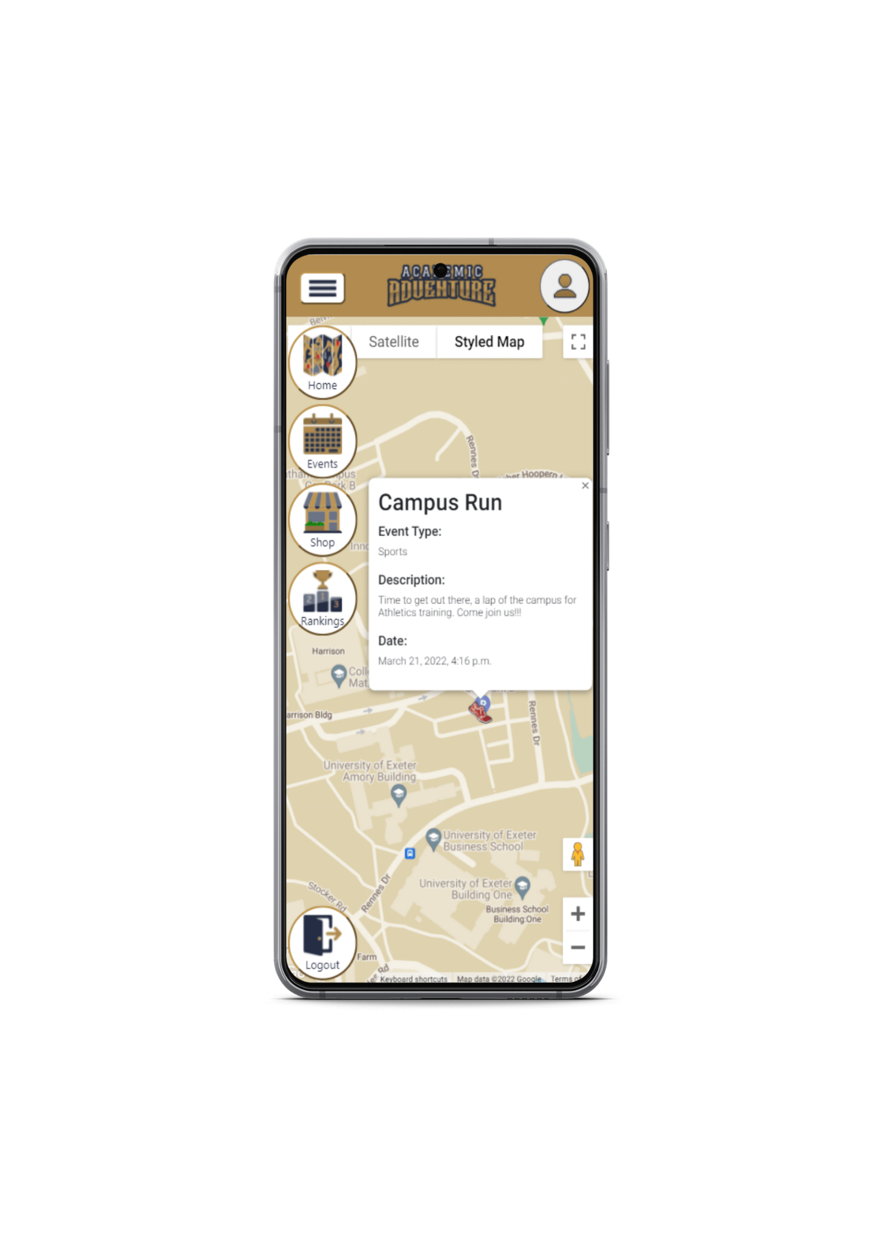






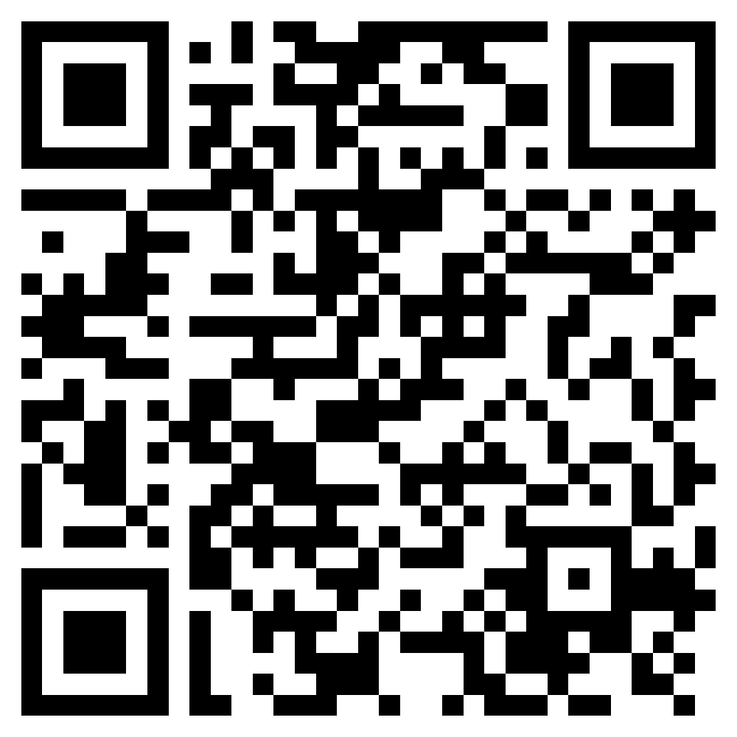
Group 19
Laison Kou, Mattis Nowell, Cameron Stackhouse, Andrew Yau, Leo Boekestein and Simon Puttock
Interactive
Map
Grow your society
Create events to increase awareness of your society, and welcome new members.
Discover new hobbies
Find events to bolster your weaker points and find a new passion.
Earn points
Attend lectures, socials, & sports events to earn points to battle with and rise the leaderboards.
Compete in Battles
Use your points in battles, earning greater point boosts if won.
Find us at:
https://academic-adventure-1.nw.r.appspot.com/academic-adventure/login/
Notes:
User story – Student:
Sam is a new student to Exeter University and is exploring the many opportunities the uni offers, he has attended some taster sessions during freshers week and has found himself a spare two hours before his next event on campus and wants to fill this spot. So he looks on his Academic Adventure map to browse all the events starting in 5 minutes or has already begun, using this interactive map he finds details for a social event and goes to it earning points. After a couple of weeks he continues to earn points from socials and academic events at uni, but during battles continues to lose due to a lack of athleticism points. This causes him to look into sports societies and decides to trial fencing to boost his points and by attending some training sessions discovered a new passion for the sport and continues to join it.
User story – Gamekeeper:
Lucy is the new social sec for the Longboarding society, as a small society she wants to boost its membership and involvement she decides to do this through Academic Adventure. By creating events she is able to reach her society to a wider audience. Firstly, she decides to create several battle events with the description regarding the society and prints off the event codes to scatter to grant a wide reach for the society. After, she creates several social events across the week open to all and suggests for people to trial out skating using the society and reward players with in game points convincing people to try it through the app.
(Possibly ignore below)
User story – Developer:
Leo is one of the developers for Academic Adventure, as a group we have just deployed the app and it is his job to keep engagement up. To do this it’s his role to when approached by an account holder to make them a gamekeeper if they have the appropriate reason to be so, he will check that they are either doing so on behalf of a society or are a staff member allowing them to then create events and keep engagement with the app up as there is more to do.

